Slide 1


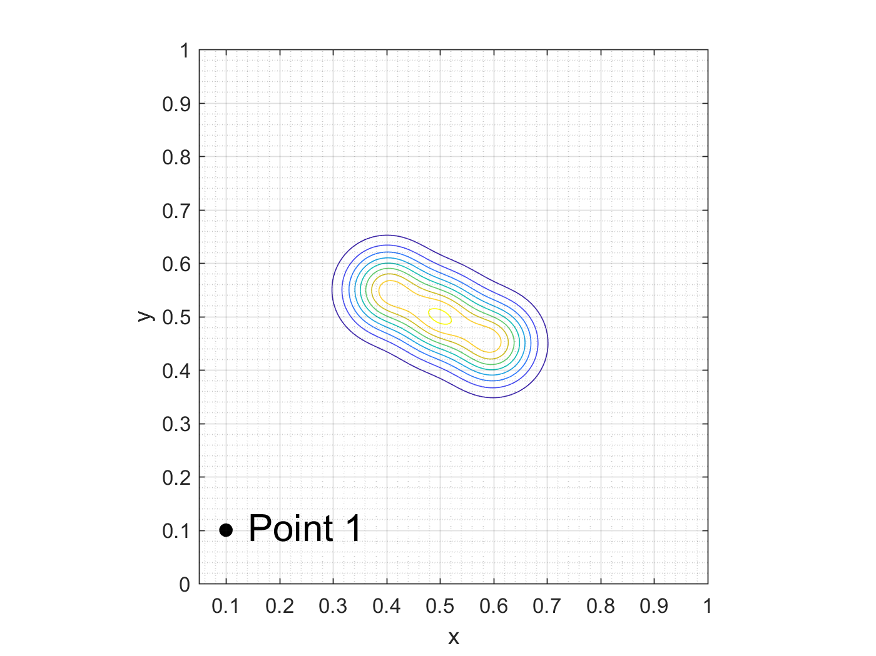
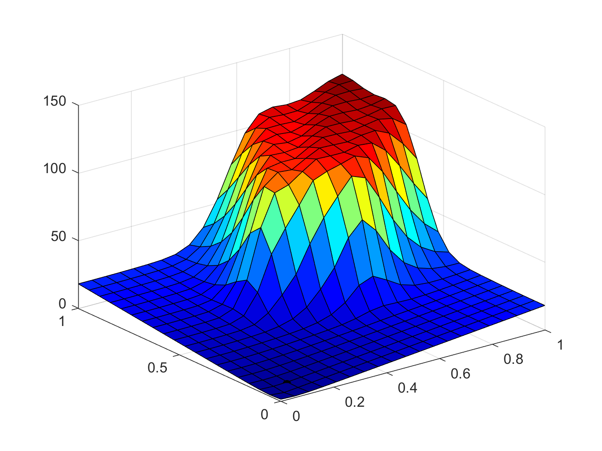
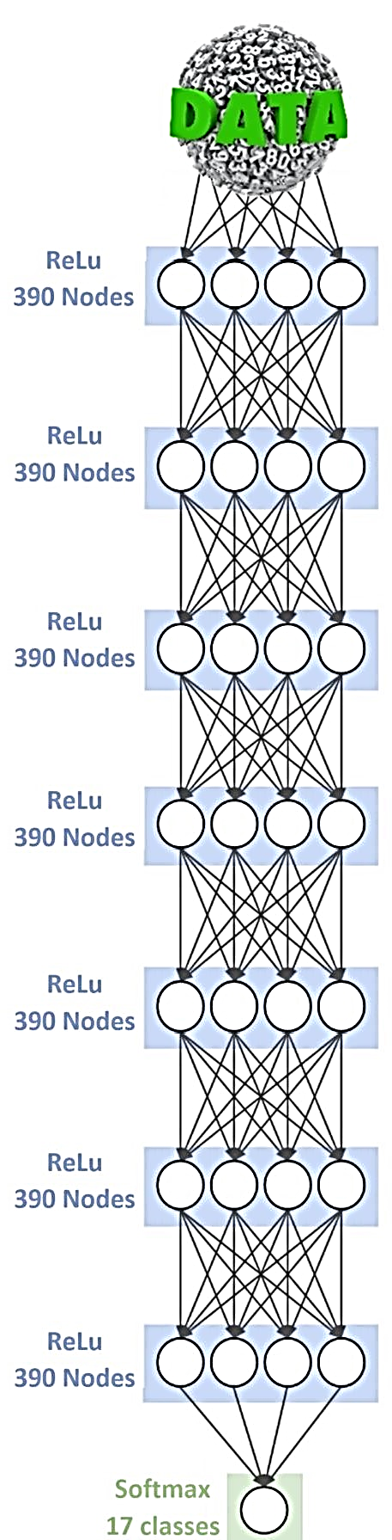
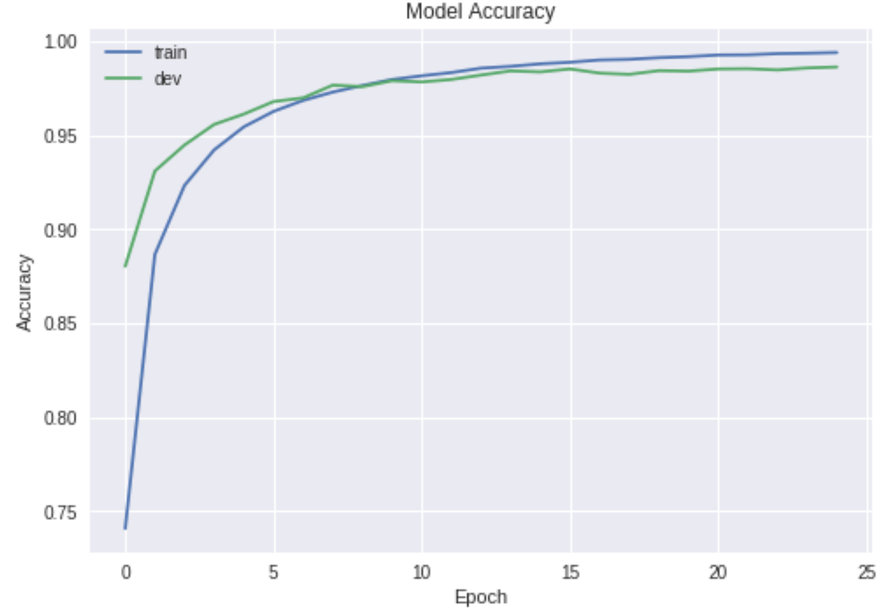
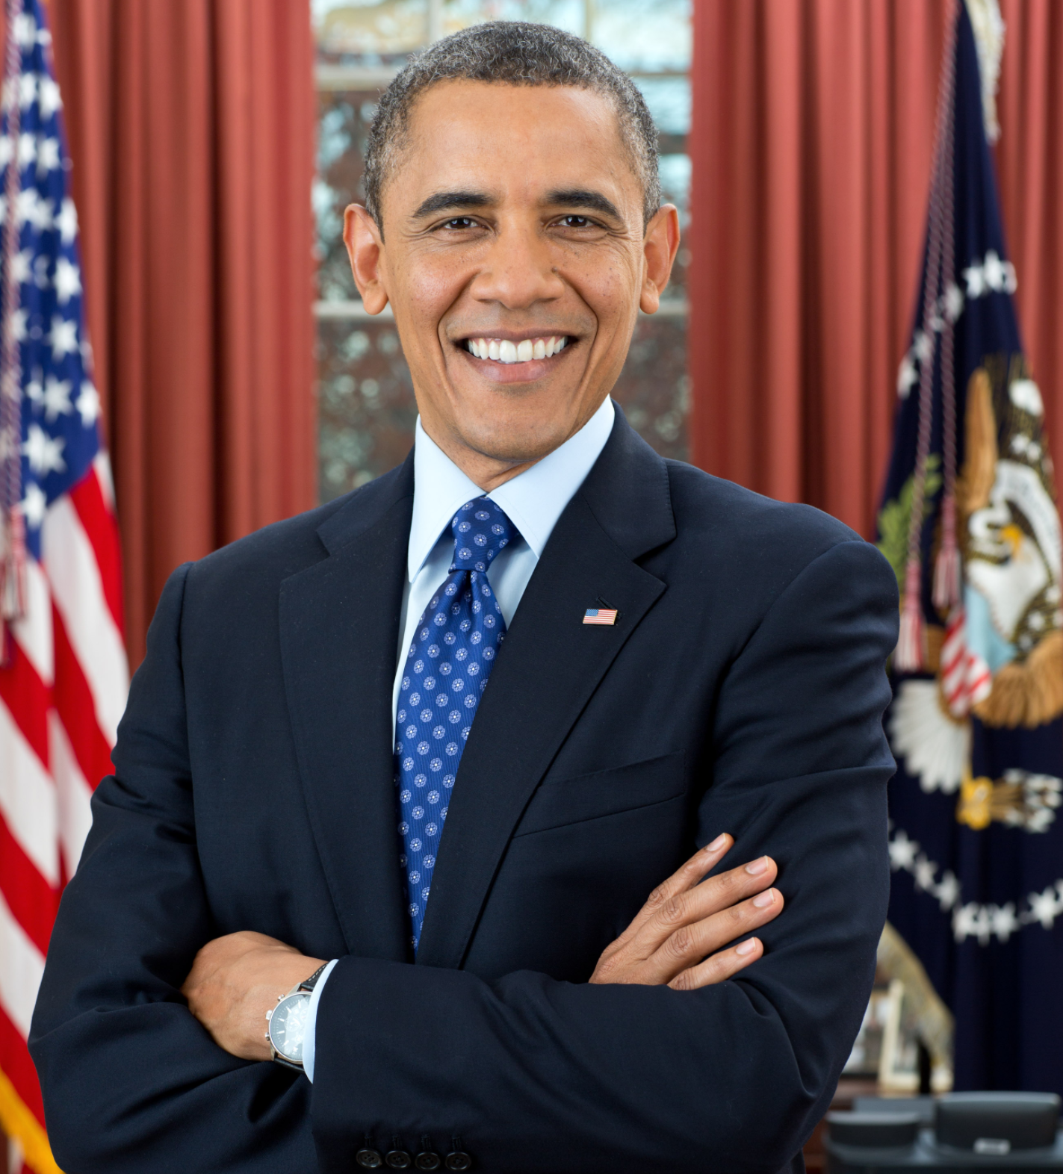
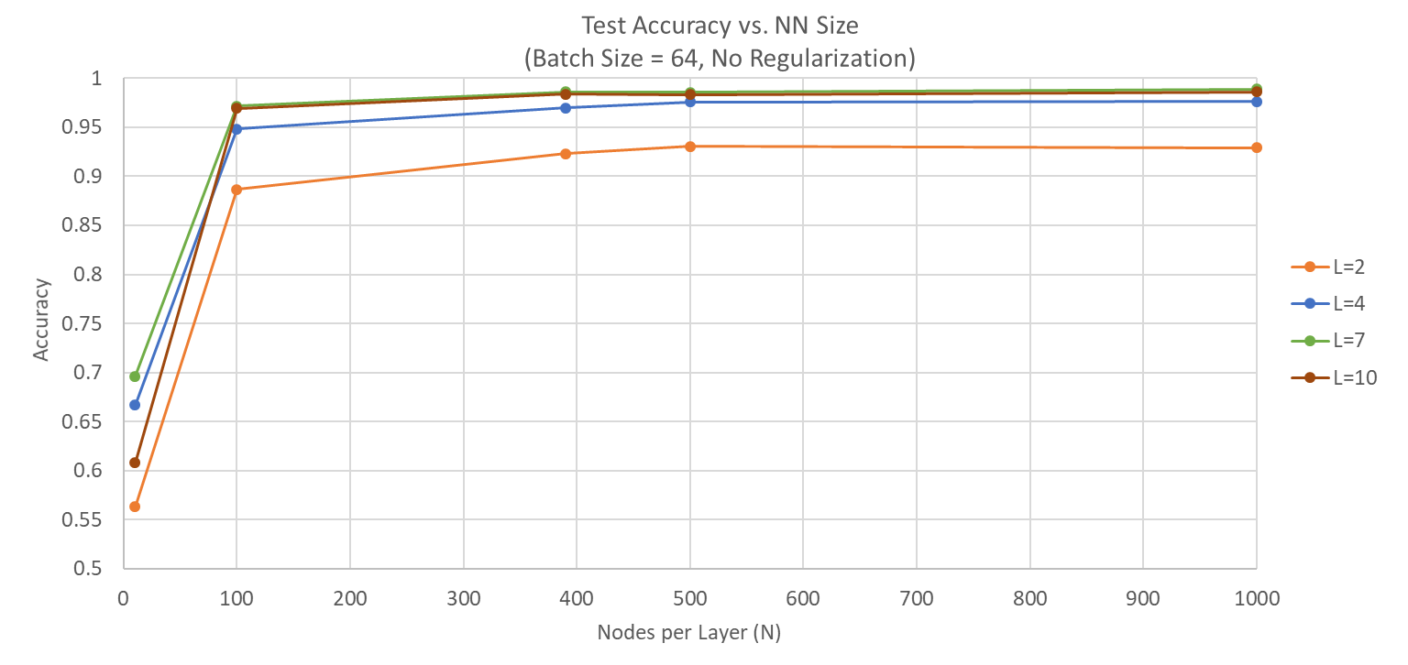

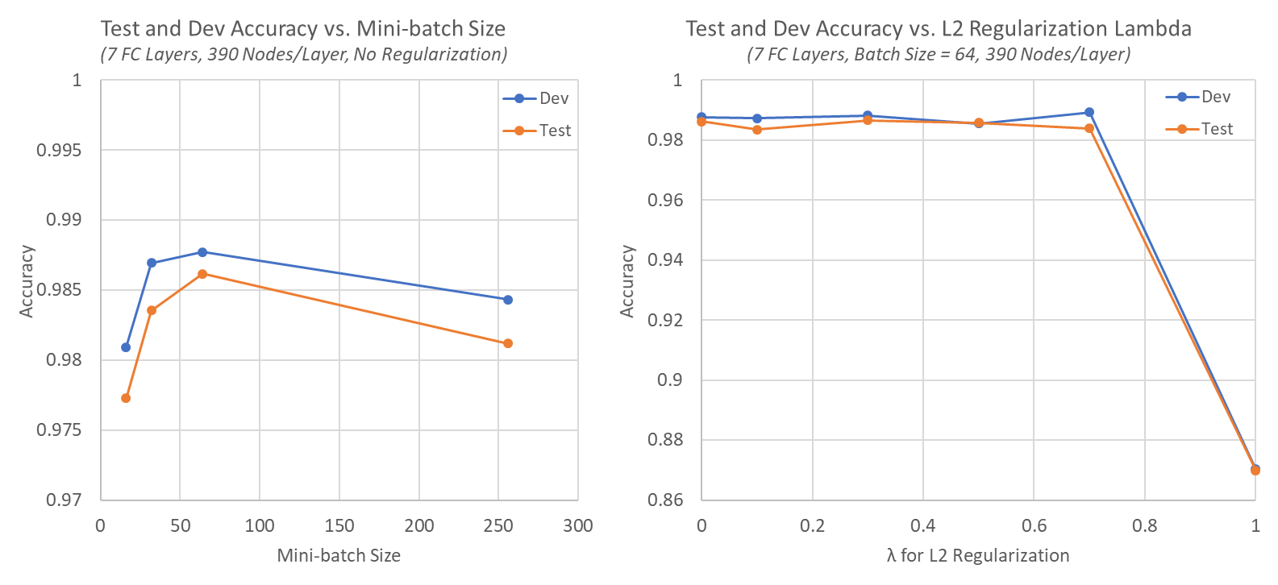

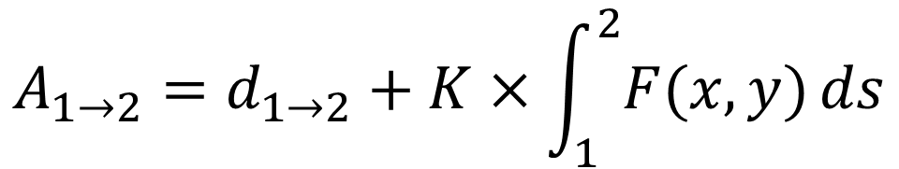
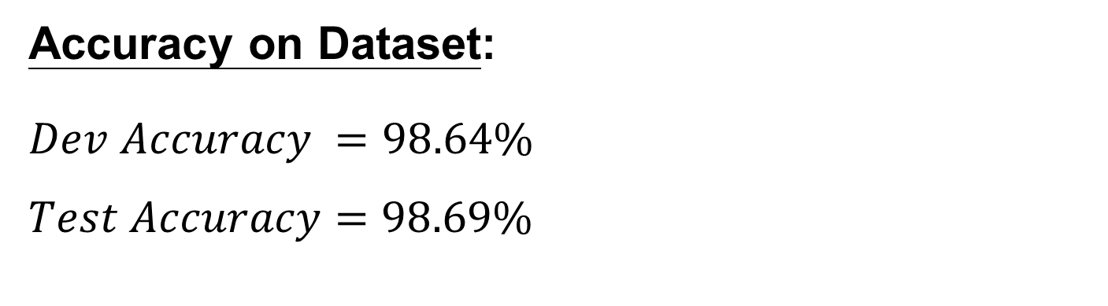
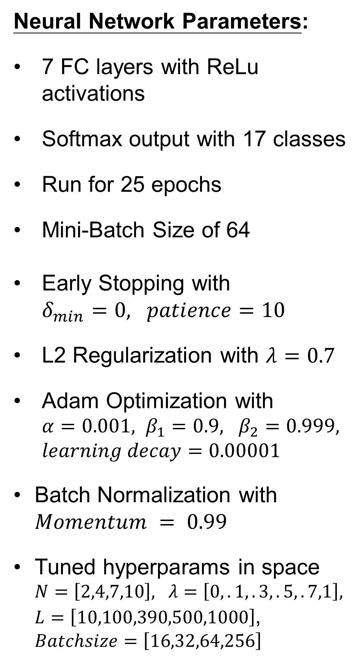
Intelligent Voice Identification
with Neural Networks
Lloyd Maza (lmaza) - Michael Thompson (mt1) - David Troner (dtroner)
CS 230 Final Project, Winter 2018
Motivation
Pre-Processing
Conclusions
Proliferation of low cost UAVs facilitates the exploration of more dangerous environments. Novel path planning algorithms are needed to control these UAVs.
Problems:
Unknown risk environment
Real time planning
Multiple cooperative agents
Multiple targets
Cooperative and Geometric Learning Algorithm (CGLA) ^{[2]}
Offshoot of Q-learning
Use UAV positions as states
Balance between minimizing path length and minimizing risk
Simplifies information sharing between agents
Generate risk map (A) of the known environment
Generate cost matrix (G)
Execute path planning
If an unmodeled threat is discovered, repeat from step 1
$$A_{1→2}=d_{1→2}+K×\int_{1}^{2}{F(x,y)}ds$$
Threat distribution
Risk map
Architecture
Results
Dataset
Neural Network Parameters:
7 FC layers with ReLu activations
Softmax output with 17 classes
Run for 25 epochs
Mini-Batch Size of 64
Early Stopping with $δ_{min}=0, patience=10$
L2 Regularization with $λ=0.7$
Adam Optimization with $α=0.001, β_{1}=0.9, β_{2}=0.999, learning decay=0.00001$
Batch Normalization with $Momentum = 0.99$
Tuned hyperparams in space $N=\left[2,4,7,10\right], λ=\left[0,.1,.3,.5,.7,1\right], L=\left[10,100,390,500,1000\right]$, $Batchsize=\left[16,32,64,256\right]$
Accuracy on Dataset:
$$Dev Accuracy =98.64\%$$
$$Test Accuracy=98.69\%$$
Future Work
Audio clips of 17 people’s voices
About 10 minutes of audio per person
Audio collected from YouTube
Expand dataset to include more people
Real-time speaker prediction
More in-depth hyperparameter search
Automated sub-captioning
Varying degrees of background noise
Each person’s audio is taken from multiple sources
References
Only one person speaking at a time
Audio is mostly of famous people
Trump, Obama, characters from The Office
[1]: Zhang, B., Mao, Z., Liu, W., et. al. "Geometric Reinforcement Learning for Path
Planning of UAVs," Journal of Intelligent and Robotic Systems, Volume 77, No. 2,
2015, pp 391–409.
[2]: Zhang, B., Mao, Z., Liu, W., et. al. "Cooperative and Geometric Learning Algorithm
(CGLA) for path planning of UAVs with limited information," Automatica, Volume
50, No. 3, 2014, pp 809-820.

